Slide 1
Design (Chapter 19)
Notes:
The slides for this text are organized into chapters. This lecture covers Chapter 5.
Chapter 1: Introduction to Database Systems
Chapter 2: The Entity-Relationship Model
Chapter 3: The Relational Model
Chapter 4 (Part A): Relational Algebra
Chapter 4 (Part B): Relational Calculus
Chapter 5: SQL: Queries, Programming, Triggers
Chapter 6: Query-by-Example (QBE)
Chapter 7: Storing Data: Disks and Files
Chapter 8: File Organizations and Indexing
Chapter 9: Tree-Structured Indexing
Chapter 10: Hash-Based Indexing
Chapter 11: External Sorting
Chapter 12 (Part A): Evaluation of Relational Operators
Chapter 12 (Part B): Evaluation of Relational Operators: Other Techniques
Chapter 13: Introduction to Query Optimization
Chapter 14: A Typical Relational Optimizer
Chapter 15: Schema Refinement and Normal Forms
Chapter 16 (Part A): Physical Database Design
Chapter 16 (Part B): Database Tuning
Chapter 17: Security
Chapter 18: Transaction Management Overview
Chapter 19: Concurrency Control
Chapter 20: Crash Recovery
Chapter 21: Parallel and Distributed Databases
Chapter 22: Internet Databases
Chapter 23: Decision Support
Chapter 24: Data Mining
Chapter 25: Object-Database Systems
Chapter 26: Spatial Data Management
Chapter 27: Deductive Databases
Chapter 28: Additional Topics

Slide 2
Introduction
Typically, the first database design uses a high-level database model such as the ER model
  This model is then translated into a relational schema
Sometimes a relational database schema is developed directly without going through the high-level design
Either way, the initial relational schema usually has room for improvement, in particular by eliminating redundancy
  Redundancies lead to undesirable update and deletion anomalies
Relational database design theory introduces
  various normal forms avoid various types of redundancies
  algorithms to convert a relational schema into these normal forms

Slide 3
Functional Dependency
Normal forms are based on the concept of functional dependencies between sets of attributes
A functional dependency (FD) X →Y is an assertion about a relation R that whenever two tuples of R agree on all the attributes of set X, then they must also agree on all attributes in set Y
Location | Store | Product | Price
Coquitlam | FutureShop | Phone | 10$
Burnaby | FutureShop | Phone | 10$
Vancouver | FutureShop | Phone | 10$
Coquitlam | BestBuy | Phone | 20$
Burnaby | BestBuy | Phone | 20$
Vancouver | BestBuy | Phone | 20$

Slide 4
Functional Dependency
We say “X →Y holds in R.”
Convention:
  X, Y, Z represent sets of attributes of relation R
  A, B, C,… represent single attributes of R.
  no parentheses to denote sets of attributes, just ABC, rather than {A,B,C }.
A FD X →Y is called trivial if .
Location | Store | Product | Price
Coquitlam | FutureShop | Phone | 10$
Burnaby | FutureShop | Phone | 10$
Vancouver | FutureShop | Phone | 10$
Coquitlam | BestBuy | Phone | 20$
Burnaby | BestBuy | Phone | 20$
Vancouver | BestBuy | Phone | 20$

Slide 5
Splitting / Combining Rule
X→A₁A₂…A_{n} holds for R if and only if each of
X→A₁, X→A₂,…, X→A_{n} hold for R.
  i.e.: knowing X, we know A₁ and A₂
  Example: The FD A→BC is equivalent to the two FDs A→B and A→C
This rule can be used to
  split a FD into multiple ones with singleton right sides
  combine multiple singleton right side FDs into one FD
There is no splitting /combining rule for left sides.
We’ll generally express FDs with singleton right sides.

Slide 6
Functional Dependency
Consider the relation
Movies1
(title, year, length, genre, studioName, starName)
title year → length genre studioName
  Holds assuming that there are not two movies with the same title in the same year.
title year → starName
  does not hold, since a movie can have more than one star acting
A FD makes an assertion about all possible instances of a relation, not only about one (such as the current) instance

Slide 7
Keys
Given a relation R with attributes X = {A₁, . . ., A_{n}}.
  is a superkey for relation R if K functionally determines X, i.e. K→ X
K is a key for R
  if K is a superkey, but no proper subset of K is a superkey
Keys are a special case of a FD.
Keys can be deduced systematically, if all FDs for relation R are given.

Slide 8
Keys
{title, year, starName} is a superkey of Movies1, since
title → title,
year → year,
title year → length,
title year → genre,
title year → studioName,
starName → starName.
Remember that title year → starName does not hold.
{title, year}, {year, starName} and {title, starName} are not superkeys.
Thus, {title, year, starName} is a key of Movies1.

Slide 9
Closure of Attributes
Given a set of attributes {A₁, . . ., A_{n}} and a set S of FDs.
The closure of {A₁, . . ., A_{n}} under S is the set of attributes X such that every relation that satisfies all the FDs in S also satisfies {A₁, . . ., A_{n}} → X,
i.e. {A₁, . . ., A_{n}} → X follows from the FDs in S.
The closure of set Y is denoted by Y^{+.}
Example
attribute set {A, B, C}
FDs {AB→D, D→E, BC→F, G→H}
{A,B,C}⁺ = {A, B, C, D, E, F}

Slide 10
Closure of Attributes
Given a set of attributes {A₁, . . ., A_{n}} and a set S of FDs.
If necessary, apply the splitting rule to the FDs in S.
Initialize X to {A₁, . . ., A_{n}}.
Repeat
search for some FD B₁, . . ., B_{m} → C in S
such that for all
and add C to the set X
until no more attribute C can be added.
Now X = {A₁, . . ., A_{n}}^{+,} , return X.

Slide 11
Closure of Attributes
Given a set of attributes {A, B, C, D, E, F}
and FDs {AB→ C, BC→ AD, D→ E, CF→B}.
What is {A,B} ⁺?
Apply the splitting rule: split BC→ AD into BC→ A and BC→ D.
Initialize X = {A,B} .
Iterations
apply AB→ C, X = {A,B,C}
apply BC→ D, X = {A,B,C,D}
apply D→ E, X = {A,B,C,D,E}
Return {A,B} ⁺ = {A,B,C,D,E}.

Slide 12
Relational Schema Design
Goal of relational schema design is to avoid anomalies.
Redundancies lead to certain forms of anomalies. and redundancy.
Update anomaly
  one occurrence of a fact is changed, but not all occurrences
Deletion anomaly
  valid fact is lost when a tuple is deleted
In the following example, consider the relation
Movies1
(title, year, length, genre, studioName, starName).

Slide 13
Relational Schema Design
title | year | length | genre | studioName | starName
Star Wars | 1977 | 124 | SciFi | Fox | Carrie Fisher
Star Wars | 1977 | 124 | SciFi | Fox | Mark Hamill
Star Wars | 1977 | 124 | SciFi | Fox | Harrison Ford
Gone with the Wind | 1939 | 231 | drama | MGM | Vivien Leigh
Wayne’s World | 1992 | 95 | comedy | Paramount | Dana Carvey
Wayne’s World | 1992 | 95 | comedy | Paramount | Mike Meyers
Update anomaly: update the length to 125 (only) for the first Star Wars tuple
Deletion anomaly: delete Vivien Leigh → we loose all information about Gone with the Wind

Slide 14
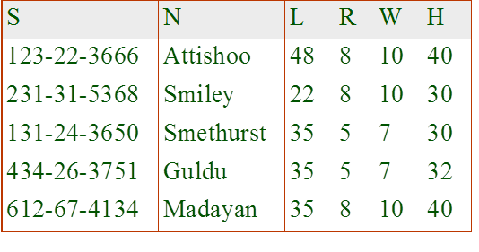
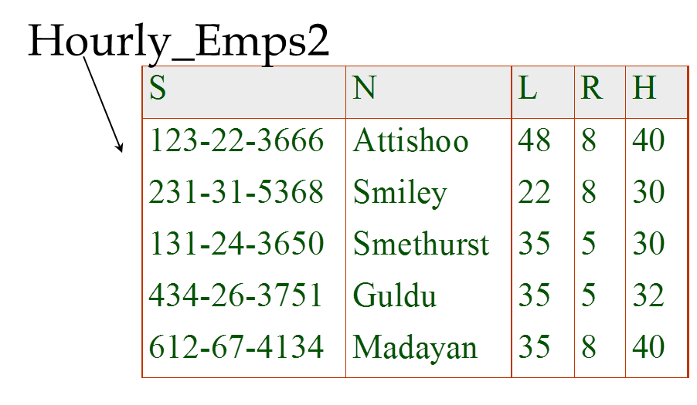
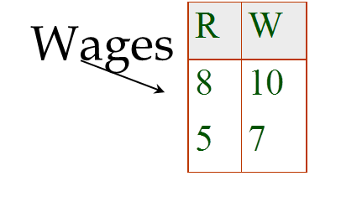
Example
Problems due to R→W :
  Update anomaly: Can we change W in just the 1st tuple of SNLRWH?
  Insertion anomaly: What if we want to insert an employee and don’t know the hourly wage for his rating?
  Deletion anomaly: If we delete all employees with rating 5, we lose the information about the wage for rating 5!
Will 2 smaller tables be better?
Notes:
17

Slide 15
Decomposing Relations

Slide 16
Decomposing Relations
How to eliminate these anomalies? Decompose the relation into two or more relations that together have the same attributes.
  Decomposition MUST be lossless.
Given relation R {A₁, . . ., A_{n}}. A decomposition of R consists of two relations S {B₁, . . ., B_{m}} and
T {C₁, . . ., C_{k}} such that
Decompose Movies1
(title, year, length, genre, studioName, starName)
into Movies2 (title, year, length, genre, studioName)
and Movies3 (title, year, starName).

Slide 17
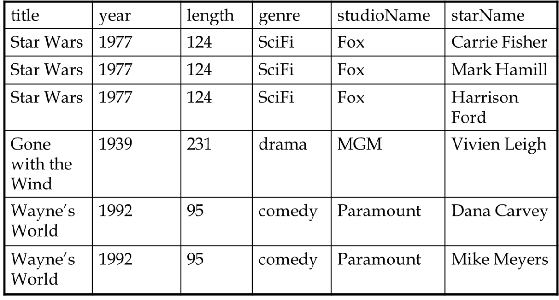
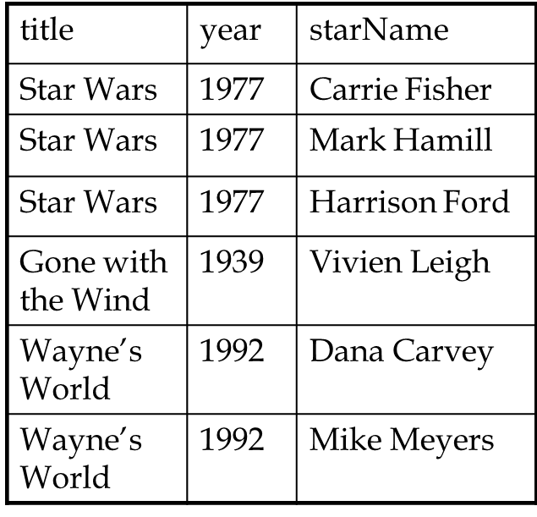
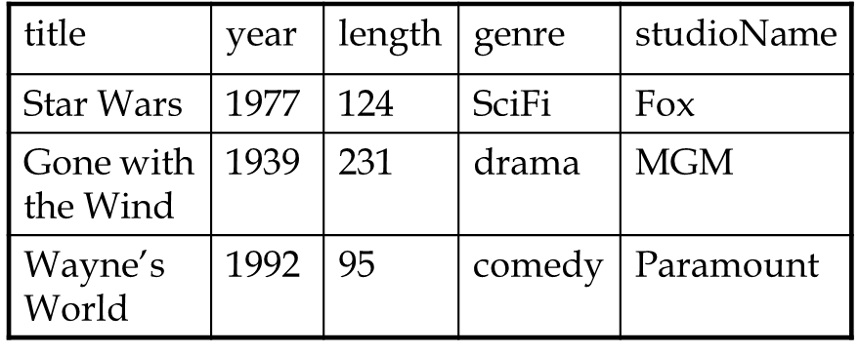
Decomposing Relations
Movies1
Movies2
→ The update and deletion
anomalies are gone!
Movies3

Slide 18
Normalization
A logical design method which minimizes data redundancy and reduces design flaws.
Consists of applying various “normal” forms to the database design.
The normal forms break down large tables into smaller subsets.
Notes:
Accomplish normalization by analyzing the interdependencies among attributes in tables and taking subsets of larger tables to form smaller ones.
The subsets are created from examining the interdependencies among the table attributes.

Slide 19
First Normal Form (1NF)
Each attribute must be atomic
  No repeating columns within a row.
  No multi-valued columns.
1NF simplifies attributes
  Queries become easier.

Slide 20
1NF
Employee (unnormalized)
Employee (1NF)

Slide 21
Functional Dependence
Employee (1NF)
Name, dept_no, and dept_name are functionally dependent on emp_no.
  (emp_no -> name, dept_no, dept_name)
Skills is not functionally dependent on emp_no since it is not unique to each emp_no.

Slide 22
Data Integrity
Employee (1NF)
Insert Anomaly - adding null values. eg, inserting a new department does not require the primary key of emp_no to be added.
Update Anomaly - multiple updates for a single name change, causes performance degradation. eg, changing IT dept_name to IS
Delete Anomaly - deleting wanted information. eg, deleting the IT department removes employee Barbara Jones from the database

Slide 23
Second Normal Form (2NF)
Each attribute must be functionally dependent on the primary key.
  Functional dependence - the property of one or more attributes that uniquely determines the value of other attributes.
  Any non-dependent attributes are moved into a smaller (subset) table.
2NF improves data integrity.
  Prevents update, insert, and delete anomalies.

Slide 24
2NF
Employee (1NF)
Employee (2NF)
Skills (2NF)

Slide 25
Transitive Dependence
Employee (2NF)
Dept_no and dept_name are functionally dependent on emp_no however, department can be considered a separate entity.
Notes:
Note, dept_name is functionally dependent on dept_no. Dept_no is functionally dependent on emp_no, so via the middle step of dept_no, dept_name is functionally dependent on emp_no.
(emp_no -> dept_no , dept_no -> dept_name, thus emp_no -> dept_name)

Slide 26
Third Normal Form (3NF)
Remove transitive dependencies.
  Transitive dependence - two separate entities exist within one table.
  Any transitive dependencies are moved into a smaller (subset) table.
3NF further improves data integrity.
  Prevents update, insert, and delete anomalies.

Slide 27
3NF
Employee (2NF)
Employee (3NF)
Department (3NF)

Slide 28
Other Normal Forms
Boyce-Codd Normal Form (BCNF)
  Strengthens 3NF by requiring the keys in the functional dependencies to be superkeys (a column or columns that uniquely identify a row)
Fourth Normal Form (4NF)
  Eliminate trivial multivalued dependencies.
Fifth Normal Form (5NF)
  Eliminate dependencies not determined by keys.

Slide 29
Normalizing our team (1NF)
games
sales
players

Slide 30
Normalizing our team (2NF & 3NF)
games
sales
players
player_stats

Slide 31
Benefits of Database Normalization
Decreased storage requirements!
1 VARCHAR(20)
converted to 1 TINYINT UNSIGNED
in a table of 1 million rows
is a savings of ~20 MB
Faster search performance!
  Smaller file for table scans.
  More directed searching.
Improved data integrity!
Notes:
And hey, odds are you can change more than one column, and you may have more than a million rows.

Slide 32
Boyce-Codd Normal Form
There are many ways of decomposing a relation.
Which decompositions leads to an anomaly-free relation?
Boyce-Codd normal form defines a condition under which the anomalies discussed so far cannot exist.
A relation R is in Boyce-Codd normal form (BCNF), if and only if the following condition holds:
  for every non-trivial FD A₁ . . . A_{n} → B₁ . . . B_{m} for R
  {A₁, . . ., A_{n} } is a superkey for R.
    I.e., the left side of a FD needs to contain a key.

Slide 33
Boyce-Codd Normal Form
Consider
  Movies1
  (title, year, length, genre, studioName, starName).
We have the FD
  title year → length genre studioName
  The left side of this FD is not a superkey, i.e. Movies1 is not in BCNF
  title year is not
  unique for all
  tuples

Slide 34
Boyce-Codd Normal Form
Consider
  Movies2
  (title, year, length, genre, studioName).
{title, year } is its only key, since neither
title → length genre studioName nor
year → length genre studioName hold.
All non-trivial FDs must have at least title and year on the left side. Thus, Movies2 is in BCNF.

Slide 35
Problems with Decompositions
There are three potential problems to consider:
  Some queries become more expensive.
  Given instances of the decomposed relations, we may not be able to reconstruct the corresponding instance of the original relation!
  Checking some dependencies may require joining the instances of the decomposed relations.
Tradeoff: Must consider these issues vs. redundancy.
Notes:
28

Slide 36
Summary
A functional dependency (FD) states that two tuples that agree on some set of attributes also agree on another attribute set.
Keys are special cases of functional dependencies.
Redundancies in a relational table lead to anomalies such as update and deletion anomalies.
A relation is in Boyce-Codd normal form (BCNF), if the left sides of all non-trivial FDs contain a key.
A schema in BCNF avoids the above anomalies.
A given schema can be decomposed into subsets of attributes such that the resulting tables are all in BCNF and the join of these tables recovers the original table.

